Slide 1



PRODUCE DOCUMENTS, REPORTS AND WORKSHEETS ON A COMPUTER
D1.HGE.CL7.10 D1.HGA.CL6.07 D2.TGA.CL6.02
Notes:
Trainer welcomes trainees to class.

Slide 2

Subject Elements
This unit comprises three Elements:
Determine presentation and format of document
Produce document
Print and deliver document
Notes:
Trainer advises that this Unit comprises three Elements, as listed on the slide explaining:
• Each Element comprises a number of Performance Criteria which will be identified throughout the class and explained in detail
• Trainees can obtain more detail from their Trainee Manual
• At times the course presents advice and information about various protocols but, where their workplace requirements differ to what is presented, the workplace practices and standards, as well as policies and procedures must be observed.

Slide 3

Assessment
Assessment for this unit may include:
Oral questions
Written questions
Work projects
Workplace observation of practical skills
Practical exercises
Formal report from supervisor
Notes:
Trainer advises that assessment for this Unit may take several forms all of which are aimed at verifying they have achieved competency for the Unit as required.
Trainer indicates the methods of assessment that will be applied to them for this Unit.

Slide 4

Element 1:
Determine presentation and format of document
Notes:
Introduce topic.
Class Activity – General Discussion
Ask general questions:
What types of documents are commonly produced in a hospitality environment?

Slide 5

Determine presentation and format of document
Performance Criteria for this Element are:
Select software appropriate to the nature of the document to be produced
Select appropriate layout and style of document consistent with enterprise guidelines
Discuss format and presentation of document with appropriate person
Notes:
Trainer identifies the Performance Criteria for this Element, as listed on the slide.

Slide 6

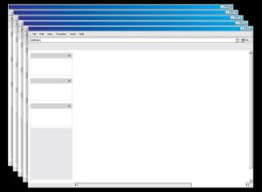
Select hardware and software
Hardware
The physical components of a computer system - everything that you can touch
Software
The programs used on a computer are called software
Notes:
Discussion – discuss difference between hardware and software
Discuss the differences.

Slide 7
Select hardware and software
Types of hardware and software
What types of hardware are used to produce documents?
What types of software are used to produce documents?
Notes:
Discussion - Compile list of hardware and software
Trainer to get audience to identify different types of hardware and software that can be used.

Slide 8
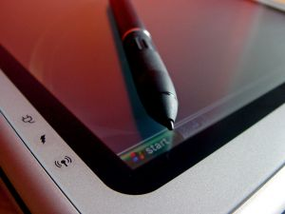
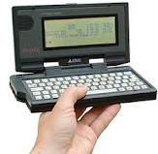
Hardware
Types of computers
Notebook or Laptop
Touch Screen PC
Palmtops
Tablets/iPads and iPhones
Notes:
Trainer to explain types of computers and his/her own experience.
Notebook or Laptop
These are portable computers which are used by people “on the go”. A notebook is similar in size to a standard book. A laptop is larger than a notebook. They are both lightweight, very convenient but are not as fast as a fixed PC, have a shorter battery life and can easily be damaged if not taken care of.
Touch Screen PC
This is a PC that can be held in the hand. A touch screen looks similar to a notebook/laptop monitor, though they can vary in style. A special pen is used to access different menu options on the touch screen. There is no keyboard or mouse.
Palmtops
Mini computers that are designed to perform basic computer functions and fit in the palm of the hand. Many are used in conjunction with a normal PC. There are different styles available. Two common types are shown. You can transfer data from your PC to the Palmtop as a reference or to edit on the go. The palmtop is not as powerful as a PC. Palmtops can be connected to the internet, or to a PC and are useful when travelling to send and receive email.
Tablets/I pads and I phones
IPads and android tablets are a combination of a modern smart phone and a laptop computer. Business owners often use tablets to get tasks done on the run, create presentations for meetings and update websites and blogs. They are lightweight, compact and affordable. They can easily be synchronised with your computer when returning to the office.

Slide 9

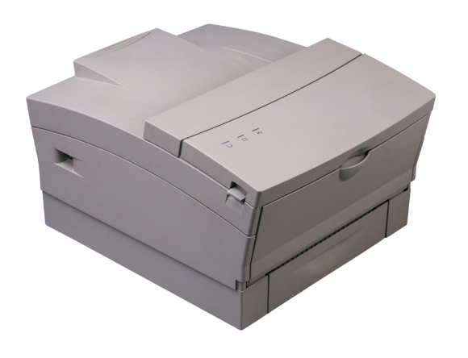
Hardware
Computers, including laptops
Digital cameras
Zip drives
Modems
Printer/scanner/photocopier combination
Facsimile
Paging equipment
Notes:
Discuss office hardware.
Can you think of any more not listed here?

Slide 10


Hardware
Calculators
Audio-transcribing machine
Telephone answering machines
External hard drives
Ergonomical mouse
Notes:
Discuss office hardware.
Can you think of any more not listed here?

Slide 11

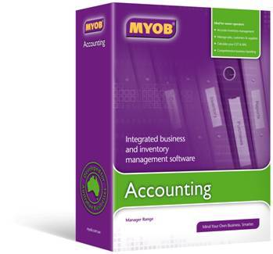


Software
Email and internet browsers
Word processing
Spreadsheets
Databases
Work project
Accounting packages
Presentation packages
Notes:
Trainer to explain the internet browsers available in their country (e.g. Internet Explorer, Mozilla Firefox) and ask what trainees use at work and at home.
Trainer to ask what software trainees use to do word processing: Word for Windows? Or do they use Apple Mac and download Word onto it? Trainer to explain there are different versions of Word e.g. 2003, 2007, 2010
Trainer to ask what spreadsheets trainees use (e.g. Excel) and what they feel is good or not as good about it. Do they know how to sort it? Enter formulas?
Trainer to explain that engineers, for example, use a project management tool called Microsoft Project which allows them to track projects
Trainer to explain that there are various packages to do accounting/bookkeeping such as MYOB, Quicken
Trainer to explain that he/she uses PowerPoint – trainer to explain its advantages for presentations.

Slide 12
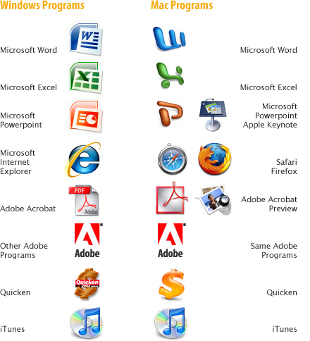
Software
Notes:
Discussion
Discuss the differences in software.
What other specific software programs are used in a hospitality environment?

Slide 13
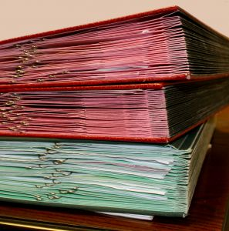

Hospitality documents
Types of hospitality specific documents
Guest mail
Customer records
Incoming and outgoing correspondence, letters, facsimiles, memos, reports
Menus
Banquet orders
Financial records, invoices, and receipts
Notes:
Class Discussion
Ask trainees for their experience in industry guidelines in their workplace
Link it to your own
Bring in some samples
Ask students to bring in non-sensitive correspondence or office documentation to show consistency across the board.

Slide 14

Generic documents
Types of generic documents
Memos
Faxes
Letters
Envelopes
Agendas
Notes:
Class Discussion & Demonstration
What is each document used for?
What information is contained in these documents?
What format do they take?
Trainer to show examples of each document

Slide 15

Generic documents
Types of generic documents
Minutes
Briefing papers
Short report
Long report
Simple one page flyers
Notes:
Class Discussion & Demonstration
What is each document used for?
What information is contained in these documents?
What format do they take?
Trainer to show examples of each document

Slide 16
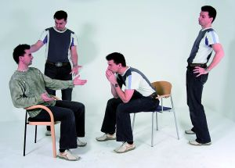

Potential audiences
Potential audiences for the wide range of documents includes:
Customers, guests and those who attend parties, conferences and seminars
Staff
Suppliers
Media
Agencies
Government bodies
Notes:
Class Discussion
What information do these audiences need?
What types of documents are normally provided to these audiences?

Slide 17
Document processing tasks
Recording receipt or sending of documents
Mailing (including bulk mailing)
Photocopying
Faxing
E-mailing
Collating and binding
Banking
Notes:
Discuss office duties
What are other common administration /office duties?

Slide 18

Discuss format and presentation of document
Appropriate person
There are a number of people who may need to approve the format and presentation used in preparing documents.
Supervisor
Originator of document
Project leader
Colleagues
Intended client – as an initial draft
Notes:
Class Discussion
Why would these people be involved?
What information is sought from these people?

Slide 19

Discuss format and presentation of document
Procedures and standards
Who has responsibility for producing and handling documents
The writing style and format to be used
Who has authority for authorising and signing documents
Filing and storing copies of documents
Use of pro forma documents
Notes:
Class Discussion
What company policies, procedures and standards impact on the preparation of documents?

Slide 20

Using different writing styles
Purpose of writing documents
They generally:
Persuade
Discuss/Argue
Inform
Notes:
Class Discussion
What is the purpose of writing documents?
What do they try to achieve?

Slide 21

Using different writing styles
Writing to persuade
Here the aim is to influence the reader and three options present themselves.
We can make an:
Emotional appeal
Factual appeal
Appeal to authority
Notes:
Class Discussion
What is the difference between these appeals?

Slide 22

Using different writing styles
Writing to develop an argument
Your argument must be:
Be sound, logical and convincing
Clarify and identify the problem being addressed
Be based on facts collected through research
Notes:
Class Discussion
What are examples of when you would use this style of writing?

Slide 23

Using different writing styles
Writing to inform
Consider your reader/audience and to
Identify their existing knowledge
Identify what is opinion and what is fact
Keep information clear and concise
Present in a logical format
Notes:
Class Discussion
What are examples of when you would use this style of writing?

Slide 24
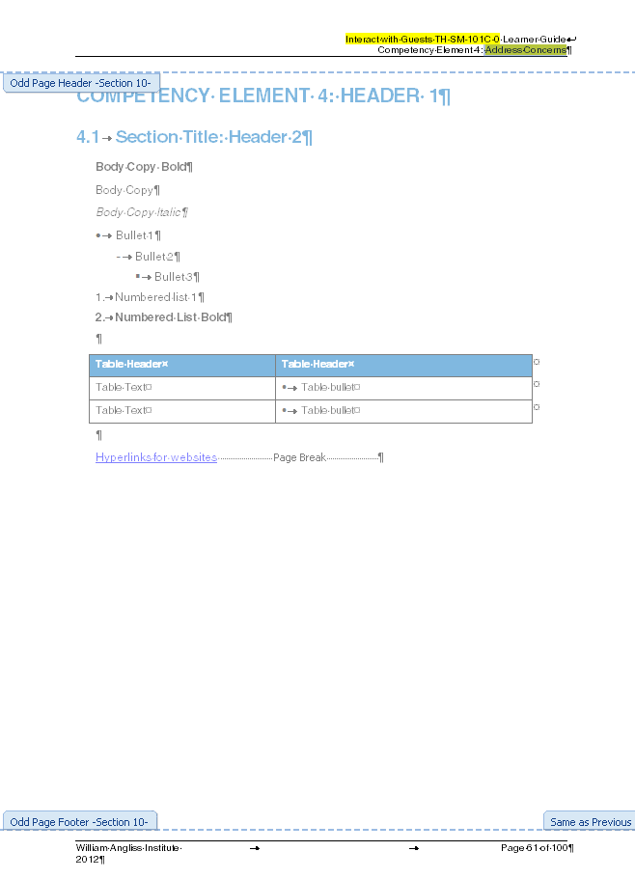
Clarification of requirements
The clarification of requirements includes confirming the following aspects of a document:
Page setup
Paragraph format
Headers and footers
Paper size and orientation
File naming system
Notes:
Class Discussion
What are some points for confirmation in each of these points?

Slide 25
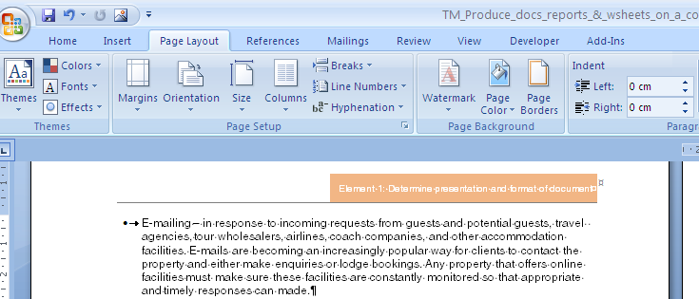
Clarification of requirements
The clarification of requirements includes confirming the following aspects of a document:
Page setup
Paragraph format
Headers and footers
Paper size and orientation
File naming system
Time limitations for production
Who to ask for help
Notes:
Class Discussion
What are some points for confirmation in each of these points?

Slide 26

Element 2:
Produce document
Notes:
Introduce topic.
Class Activity – General Discussion
Ask general questions:
What needs to be considered when producing documents?

Slide 27
Produce document
Performance Criteria for this Element are:
Produce document in required style and format
Produce document within designated timelines
Save document regularly to avoid loss of data
Information from same or other software packages is integrated as required
Proof read draft document prior to printing
Notes:
Trainer identifies the Performance Criteria for this Element, as listed on the slide.

Slide 28
Type of business documents
Business letter
Minutes
Agenda
Report
Memo/Email
Invoice
Receipt
Message
Notes:
Explain each business document by giving them samples you have brought along to class.

Slide 29
Prepare documents
Basic principles:
Introduction
Body
Summary
Introduce the subject
One idea only.
All information must be grouped
Chunking: breaking down of info
Summarise all you have said
Action.
Labelling
Integrated graphics.
Notes:
Discuss the basic principles involved in preparing documents.

Slide 30

Six steps to good writing
1:
2:
3:
4:
5:
6:
Be clear about your purpose
Plan what you will say
Draft your document
Edit
Type the final draft
Proof read
Notes:
Discuss the six steps to good writing.

Slide 31



Different styles of letters
Modified Block Style Full Block Style Semi block Style
Notes:
Trainer to ask trainees to bring a sample of each different style of letter as above.
Ask trainees which one is which.
Trainer to ask trainees to bring in samples and ask them to identify differences.

Slide 32
Different styles of letters
Modified Block Style
Sender’s address is blocked to the right margin.
Date is in line with the sender’s address
Recipient’s address and the salutation are placed against the left-hand margin
The complimentary close and signature blocks are centred in line with the writer’s address and the date.
Each paragraph is blocked against the left-hand margin
More conservative style of layout.
Notes:
Trainer to ask trainees to bring a sample of each different style of letter as above.
Ask trainees which one is which.
Trainer to ask trainees to bring in samples and ask them to identify differences.

Slide 33
Different styles of letters
Full block style
Attractive and modern layout that is easy to read.
Each part of the letter is placed against the left-hand margin of the page (the sender’s address, the date, the inside address and the salutations).
Supplementary parts such as enclosures, file numbers and copy notations are also blocked.
Notes:
Trainer to ask trainees to bring a sample of each different style of letter as above.
Ask trainees which one is which.
Trainer to ask trainees to bring in samples and ask them to identify differences.

Slide 34
Different styles of letters
Semi block style
This is the most conservative of the three layouts.
Uses the same layout as Modified Block Style, except that the first line of each paragraph is indented from the left-hand margin.
Notes:
Trainer to ask trainees to bring a sample of each different style of letter as above.
Ask trainees which one is which.
Trainer to ask trainees to bring in samples and ask them to identify differences.

Slide 35

Memos versus letters
Memos: internal Letters: external
Memo
Date: 19 December 2012
To: Hospitality staff
From: Birgitta March
Re: Work placements
You are invited to a meeting to discuss work placements for our hospitality volunteers for the upcoming New Year's Eve function.
Time: 10 am
Date: 22 December 2012
Where: Meeting room B245, level 3
R.S.V.P: By 21 December 2012
Email: birgittam@angliss.edu.au
I hope you can all attend.
Notes:
Discuss sample memo in slide.

Slide 36
Preparing letterheads
Essential Parts
Writer’s name and address
Date
Inside address
Greeting or salutation
Body of the letter
Complimentary close
Writer’s signature and job title or designation
Notes:
Activity
Trainer to show example or get audience to prepare a letterhead.

Slide 37
Routine letters
Opening Paragraph | Refer to the communication they sent to you | Here is the information you asked for in your letter of 12 November. In your letter of 9 June, you asked for... In reply to your letter of 8 August...
Middle Paragraphs | Provide complete information | I have enclosed a brochure detailing our hotel...
Ending Paragraph | Include a goodwill close | If I can be of any further assistance please don’t hesitate to contact me on the above contact numbers.
Notes:
Discuss sample routine letter in slide.

Slide 38
Good news letters
Opening Paragraph | Write the good news | Although the warranty on your heater ended six months ago, we have decided to replace it without further charge. We overestimated the costs of repairs to your roof. The account will be $700.00 less than we anticipated.
Middle Paragraphs | Provide relevant detail | Our repair staff have thoroughly tested the heater over three months and found that...
Ending Paragraph | Repeat the good news | Please telephone our office to make a suitable time for our plumber to fit your new heater. Our cheque for seven hundred dollars is enclosed.
Notes:
Discuss sample good news letter in slide.

Slide 39
Bad news letters
Opening Paragraph | Allude to the situation with a neutral comment | The heating unit that you returned has been checked by our laboratory. The cost of the repairs to your roof which we originally estimated at $8000 can now be compared with the actual costs of the materials.
Middle Paragraphs | Give details and reasons. State the bad news. Provide workable alternatives. | In the process of installation your heater has received some damage which has stopped the flow of water into the unit. Broken pipes may result from improper positioning during installation or from mistreatment of the pipes once they are in place.
Ending Paragraph | Close with a neutral or positive statement. | We can recommend an excellent tradesman to correctly install one of our new heaters. Thank you for thinking of us for your heating needs.
Notes:
Discuss sample bad news letter in slide.

Slide 40
Preparing short report
A short report can describe progress on a project and present information.
Introduction
Main body
Conclusion
Recommendations
Notes:
Activity
Trainer to show an example of this document.

Slide 41
Preparing long report
Long reports will provide exhaustive data, and supply informed opinion and advice on a nominated topic, problem or issue.
Title page
Table of contents
Introduction
An ‘Executive Summary’
Main body
Conclusions
Recommendations
Bibliography/references
Notes:
Activity
Trainer to show an example of this document.

Slide 42

Preparing submissions
Submissions are commonly created when you make a request for funds or seek authorisation to amend a current practice, procedure or protocol.
There are three critical elements to any submission:
Define the problem
Define current position
Seek authorisation to take action to fix the problem
Notes:
Activity
Trainer to show an example of this document.

Slide 43

Preparing submissions
Submission inclusions
Title page
Introduction
Main body
Conclusion
Recommendation
Space for signatures and approval
Notes:
Activity
Trainer to show an example of this document.

Slide 44
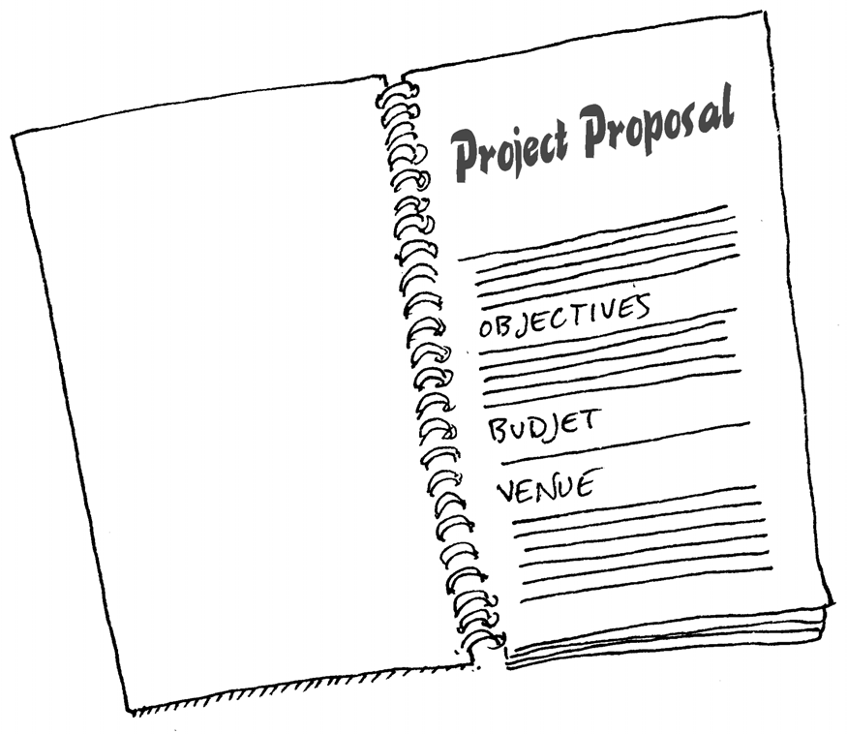
Preparing proposals
Proposal format
Cover page
Executive Summary
Introduction
Description of management of the project
Description of qualifications and experience of the organisation/individuals
Notes:
Activity
Trainer to show an example of this document.

Slide 45
Preparing proposals
Proposal format
Outline of the budget
Proposed schedule
Description of terms and conditions
Summary
Attachments and appendices
Notes:
Activity
Trainer to show an example of this document.

Slide 46
Preparing tenders
Tender inclusions
The purpose of the project
Your ability to meet the project objectives
The budget
Funding conditions and conditions of payment
The timeframe for completion
Notes:
Activity
Trainer to show an example of this document.

Slide 47
Produce documents within timelines
Types of timelines
Immediately
By a set date
No hurry
Notes:
Questions
Why is it important to have deadlines?
When would each of these deadlines be appropriate?

Slide 48

Produce documents within timelines
Timing considerations
Each document that needs to be prepared should be awarded a suitable amount of time to:
Conduct necessary research to compile information
Hold relevant meetings and discussions required
Type the actual document
Review and collect feedback
Distribute or transport final document
Notes:
Questions
What other considerations may need to be taken into account?

Slide 49

Types of software functions
Default settings
Page setup
Paragraph formatting
Text formatting
Tabs
Line spacing
Page numbering
Headers and/or footers
Application of spell check
Indenting
Document protection protocols
Notes:
Questions
How can different software packages affect a document?
How do their functions differ?
What needs to be taken into consideration if transferring a document between different software systems?

Slide 50

Save document regularly
Methods to store data
Storage in directories and sub-directories
Storage on hard drive
Storage on networked computers
Storage of memory sticks
Storage on CD-ROMs
Storage on portable hard drives
Appropriate storage/filing of hard copies
Notes:
Questions
Why is it important to save documents on a regular basis?
Which methods are commonly used and why?

Slide 51

Proof read prior to printing
Principles of proof reading
Proofreading may involve:
Utilising spell check function of software
Utilising grammar check function of software
Checking page break placement
Checking hard copy of document
Checking soft copy of document
Notes:
Questions
Why is it important to proof read documents?
What do you look for during this process?

Slide 52

Rule of 7 Cs
Clear
Concise
Complete
Correct
Courteous
Clean
Checked
Notes:
Rule of 7 Cs:
Clear - able to be understood in one reading by the recipient (time = money).
Concise - conveying what has to be stated with a minimum of words, sentences and paragraphs.
Complete - all of the information necessary to understand the correspondence is passed on.
Correct - all of the information conveyed is accurate.
Courteous - your tone is always polite as you are representing your organization and wish to create goodwill.
Clean - this means that there are no coffee stains, liquid paper, or crossing out on your correspondence. It also means that your work is not cluttered and there is plenty of white space so that the document looks appealing and professional.
Checked - this means your work has been examined for spelling mistakes, grammatical mistakes, format and layout and found to be mistake-free.

Slide 53




Check spelling
Online dictionaries/thesauruses
www.dictionary.com
www.thefreedictionary.com
www.thesaurus.com
www.macquariedictionary.com.au
Notes:
Trainer to go online and show trainees online dictionaries.
Ask trainees to look up the words ‘scope, pax, FIT’ in all dictionaries and in the thesaurus. Which one did they prefer? Why? Suggest to bookmark them as a favourite on their computer for future use.

Slide 54
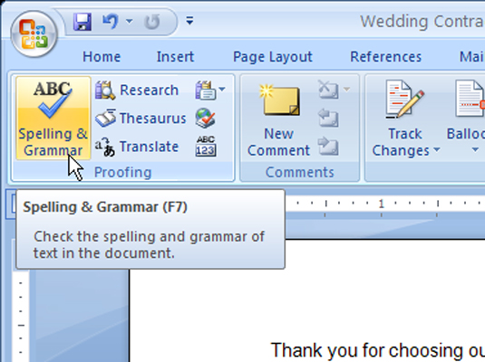
Ensure text is without spelling, punctuation and/or grammatical errors
Necessary tasks
Running a spell check
Follow spelling rules
Omit unnecessary words
Correct use of punctuation marks
Notes:
Questions
Why is it important to undertake these activities?

Slide 55
Element 3:
Print and deliver document
Notes:
Introduce topic.
Class Activity – General Discussion
Ask general questions:
What tasks are associated with printing a document?
What other preparation tasks are involved in preparing documents and attachments to the audience?
How can documents be delivered to the intended audience?

Slide 56
Print and deliver document
Performance Criteria for this Element are:
Utilise printing function
Proofread document
Make any necessary modifications to document to improve appearance and meet required specification/s
Print and present documents according to requirements
Notes:
Trainer identifies the Performance Criteria for this Element, as listed on the slide.

Slide 57

Print document
Now that the document has been prepared it is now time to:
Print
Review to ensure it is correct
Make ready for distribution to the intended audience
Notes:
Questions
Why is it important to undertake these activities?

Slide 58
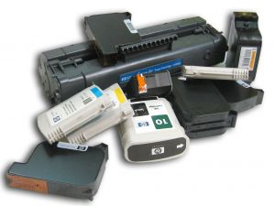
Print document
Check printer
Ensure printer is attached
Appropriate paper
Adequate toner
Notes:
Questions
What else can impact on whether a document can print?

Slide 59
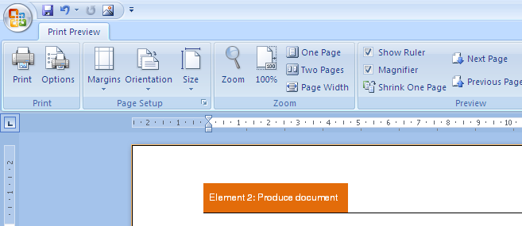
Print document
Conduct print preview
Using the Print Preview facility can help to:
Identifies areas that require attention before the final article is printed
Makes it easier to review
Helps identify positioning of the letter on the page
Helpful in determining overall balance and layout
Notes:
Questions
Why else is a print preview important in your view?

Slide 60
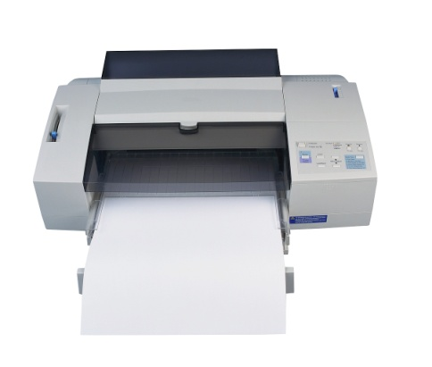
Print document
Printing from Word
There are three methods that can be used to print from word:
File Menu option
Printer icon
Shortcut key Ctrl-P
Notes:
Questions
Which one do you use?

Slide 61

Proof read document
Proof reading requirements
Check the finished article
Check the sequencing
Check layout
Check the attachments
Check the mailing details
Check the spelling and grammar
Observe confidentiality
Notes:
Questions
Why is proof reading important?

Slide 62

Collective advice from others
Purpose of presenting and circulating documents
A writer may wish to present a document in draft format to:
Gather feedback
Gain suggestions for improvement
Notes:
Questions
Why is getting feedback important?
What types of feedback do you wish to get?

Slide 63

Collective advice from others
Issues for discussion
Purpose and flow
Content
Spelling, grammar and punctuation
Layout and style
Notes:
Questions
Discuss these points.

Slide 64

Collective advice from others
Issues for discussion
Smooth flow of the document
Accurate comments and use of data
Referencing of data and statistics
Recommendations or action required
Notes:
Questions
Discuss these points.

Slide 65

Collective advice from others
Methods of presenting and circulating documents
Mail
Email
Fax
By hand
Courier
As an accompaniment to an oral presentation
Notes:
Questions
When would each method be the most appropriate?

Slide 66

Make modifications to documents
Types of modifications
Changing information within document
Streamlining wording
Change page size and orientation
Change page margins
Add/delete columns
Formatting
Notes:
Discussion
Discuss these formats.

Slide 67

Make modifications to documents
Types of modifications
Copying, cutting and pasting
Inserting page breaks and section breaks
Inserting or changing headers and footers
Inserting page numbers
Adding styles
Notes:
Discussion
Discuss these formats.

Slide 68
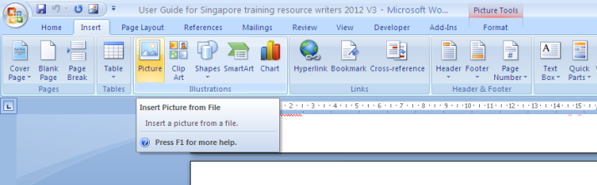
Make modifications to documents
Types of modifications
Inserting and formatting tables
Saving documents
Inserting images and graphics/clip art
Inserting smart art and shapes
Check spelling and grammar
Notes:
Discussion
Discuss these formats.

Slide 69

Make modifications to documents
Types of modifications
Attaching documents
Saving and naming documents
Copying files/folders
Setting up the correct printer
Notes:
Discussion
Discuss these formats.

Slide 70

Print and present documents
Print and present document
Now that all necessary amendments have been made to documents it is now time to:
Print the final copy
Undertake any additional activities to get document ready
Notes:
Discussion
What additional activities may need to be undertaken?

Slide 71

Print and present documents
Additional requirements
Producing multiple copies
Collating documents
Adding attachments
Binding
Notes:
Discussion
What equipment is required?
What materials are needed?
What tasks are involved?

Slide 72

Print and present documents
Additional requirements
Mailing
Disseminating internally
Recording dissemination in a file or book
Filing
Notes:
Discussion
What equipment is required?
What materials are needed?
What tasks are involved?

Slide 73

Print and present documents
Preparing for signature and posting
Who signs documents?
Who gives final authorisation that documents are complete?
Notes:
Discussion
Discuss questions in the slide

Slide 74

Print and present documents
Additional tasks
Attaching enclosures
Folding an envelope
Folding a standard letter
Notes:
Discussion
What is associated with conducting these additional tasks?

Slide 75

Finish:
Thank you!
Notes:
This is the conclusion of the subject.
Thank the audience and deliver assessments as required.

